Slide 1
Edumation Lab

Slide 2
Project Name Infographics on Chemical Bond

Slide 3
Multimedia Production
Producer - Dr. Mohammad Zahidur Rahman
Project Manager - Nishat Tasnim
Stroy Teller /Writer - Asraf Ullah Rahat
Script Writer
- Asraf Ullah Rahat
- Nishat Tasnim
Art Director
- Abdullah Al Shaikh
- Asraf Ullah Rahat
UI designer - Jubair Al Faisal

Slide 4
Production Artist(voice)
- Fatema Jannat Tisha
- Nishat Tasnim
Production Artist(Sketch)
- Tasmim Sultana
- Fatama Jannat Tisha
- Jubair Al Faisal
Sound designer - Uzma Hanian
Video Editor
- Abdullah Al Shaikh
- Abdul Mukit
Animators - All team members

Slide 5
Software Component
Blender - For animation
Kdenlive – Editing video and sound
Ardoure6 – Voice recording and audio editing
GanttProject – For task and time managing
GitHub – For collaborating and version managing

Slide 6
Project Description
We are proposing to create an infographic on the Chemistry book of class 9-10. We are wishing to create an E-learning material on chapter 5th (Chemical Bond). Our students are often stuck on visualizing actually how the atoms bond with each other. There can’t be anything more impeccable than infographics to help the student to get the concept.
Three types of chemical bonds are Ionic bonding, Covalent bonding, and Metallic bonding. We will show some examples of these kinds of bonds. For example, the Formation of sodium chloride, the formation of Hydrogen molecules, etc.

Slide 7
What we have done-
Story writing
Script writing
Sketching
Demo model using Blender(50% done)

Slide 8
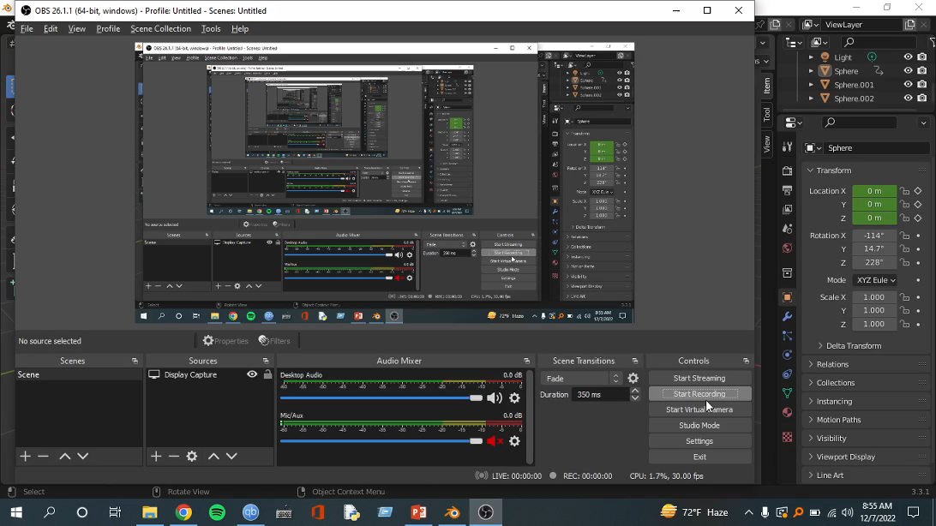
Our demo video model

Slide 9
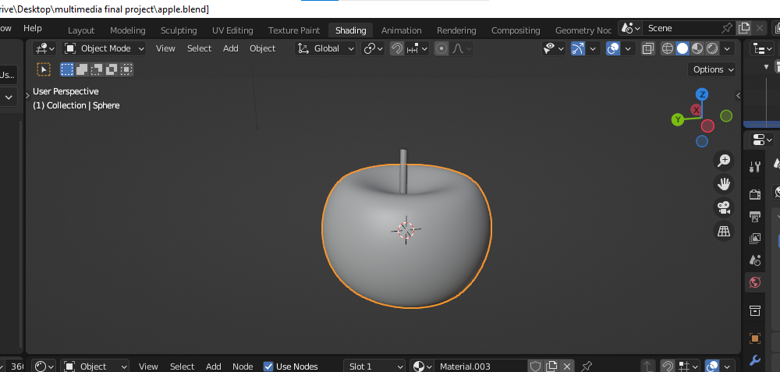
Object we will be using

Slide 10
Key issues while doing this job-
For script writing – Scene to scene transition problem
For sketching – Synchronization to script to sketch
For modeling - General Model for all animation

Slide 11
Our next tasks to do -
Completing our animation model
Rendering
Combining
Voice Recording
Video Editing

Slide 12
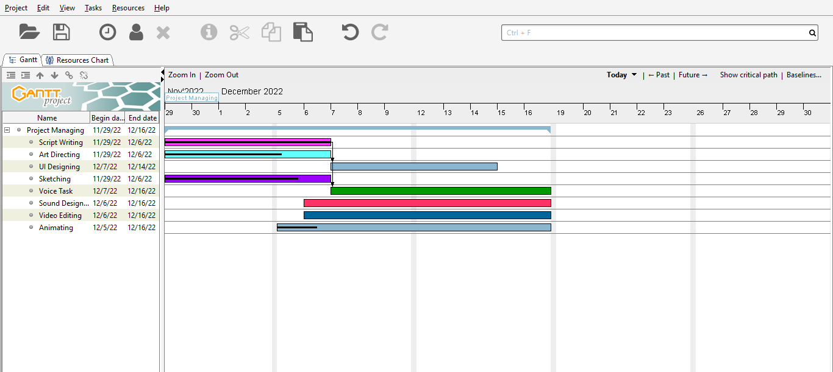
Gantt Project Timeline

Slide 13
Thank You For Your Attention

